Slide 1
PROJECT
PRESENTATION

Slide 2

student performance tracker

Slide 3
PROBLEM STATMENT
Student progress is hard to track because information is spread out in different places.
Teachers often find problems too late, when students are already struggling.
3.Supports are confusing and don’t show clearly how students are doing over time.
4.Every student learns differently, but schools don’t always have tools to support that.
5.Parents and students don’t get regular updates, so they don’t know

Slide 4
objectives
Track Student Progress
Identify Learning Gaps
3.Improve Communication
4. Boost Overall Performance

Slide 5
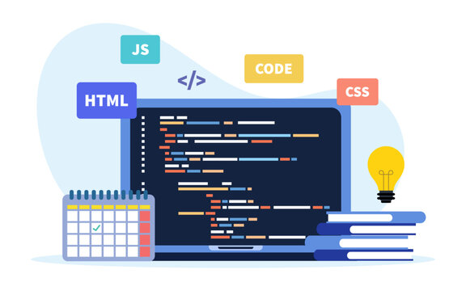
TOOL USED
TO DEVELOP THIS APPLICATION WE USED: HTML CSS JS WEB CHROME VS CODE WEB APPLICATION SOFTWARE (NO BACKEND)

Slide 6
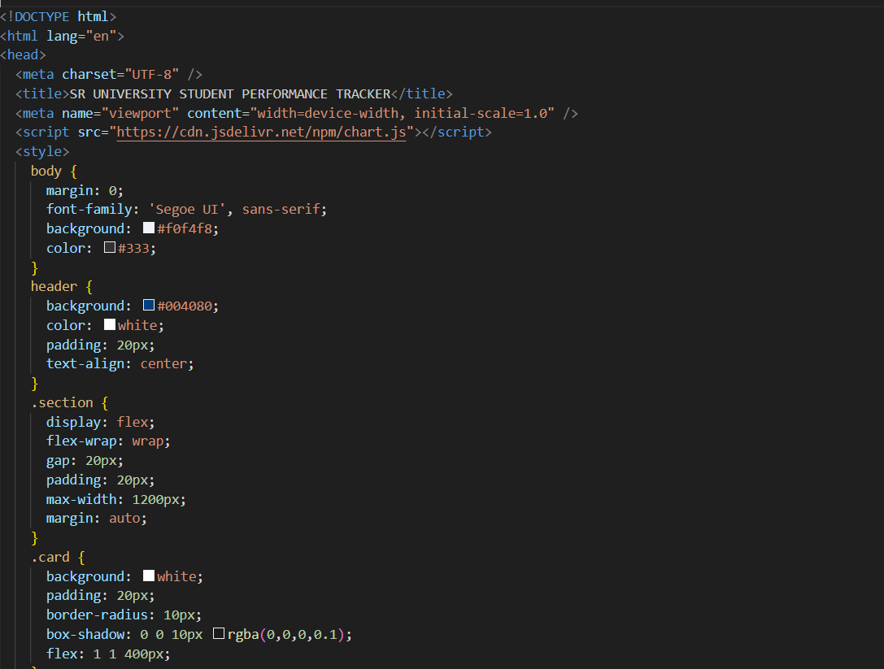
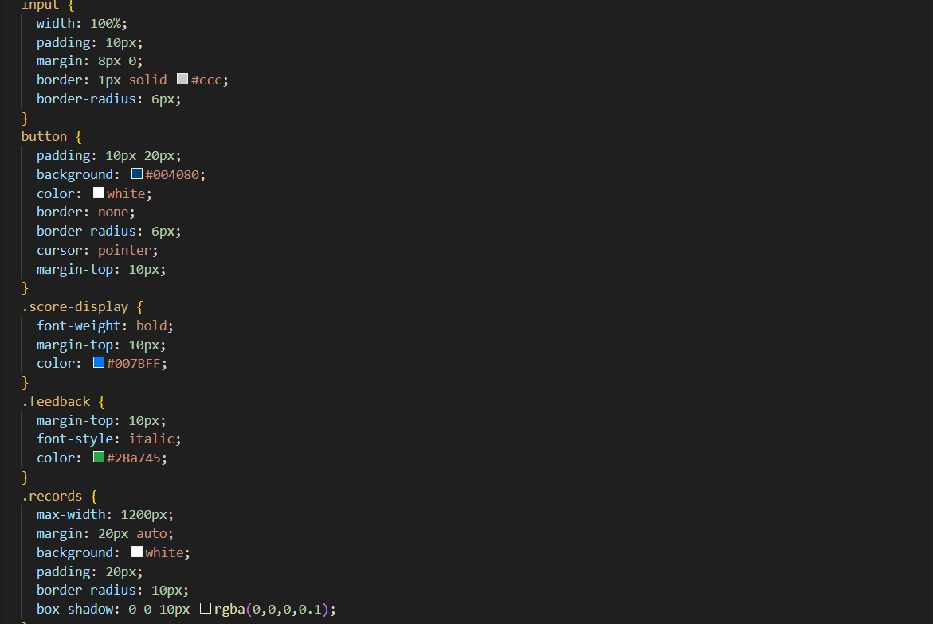
Project code

Slide 7
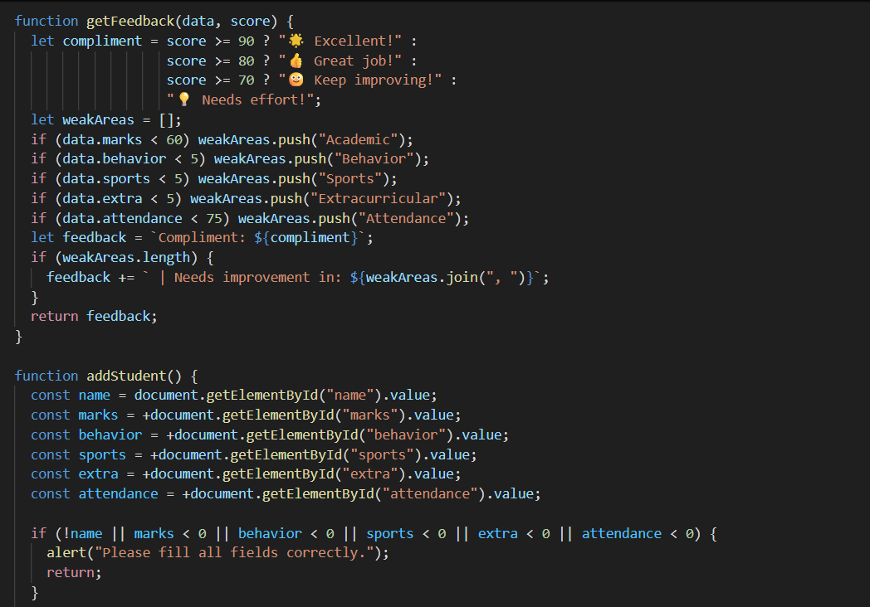
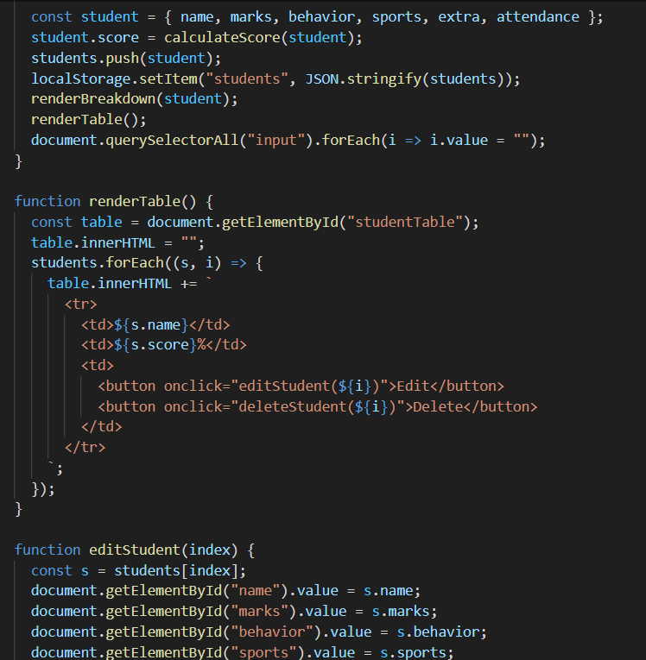

Slide 8
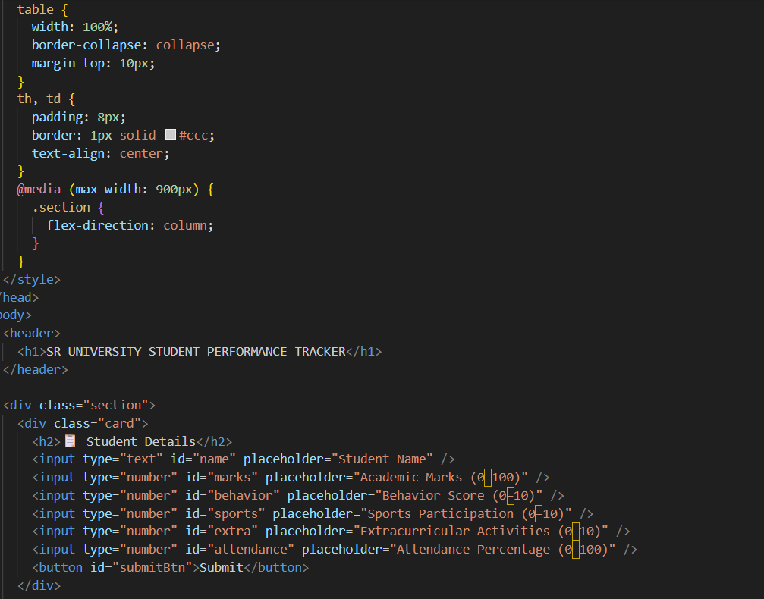
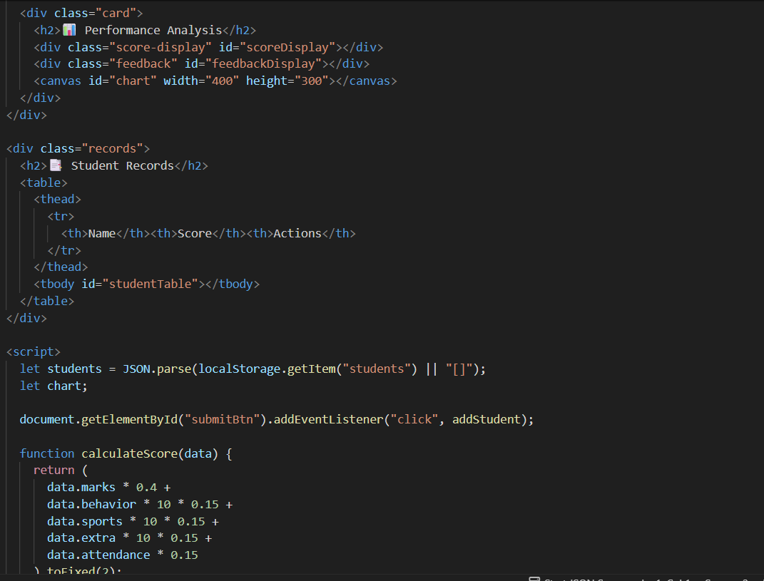

Slide 9
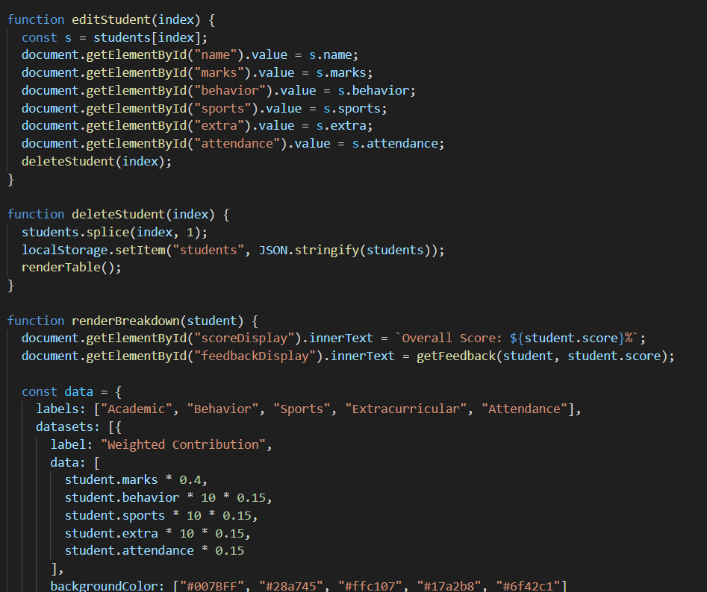
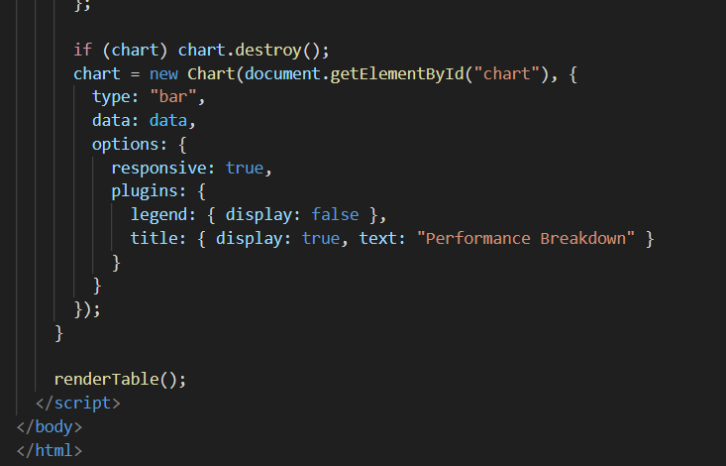

Slide 10
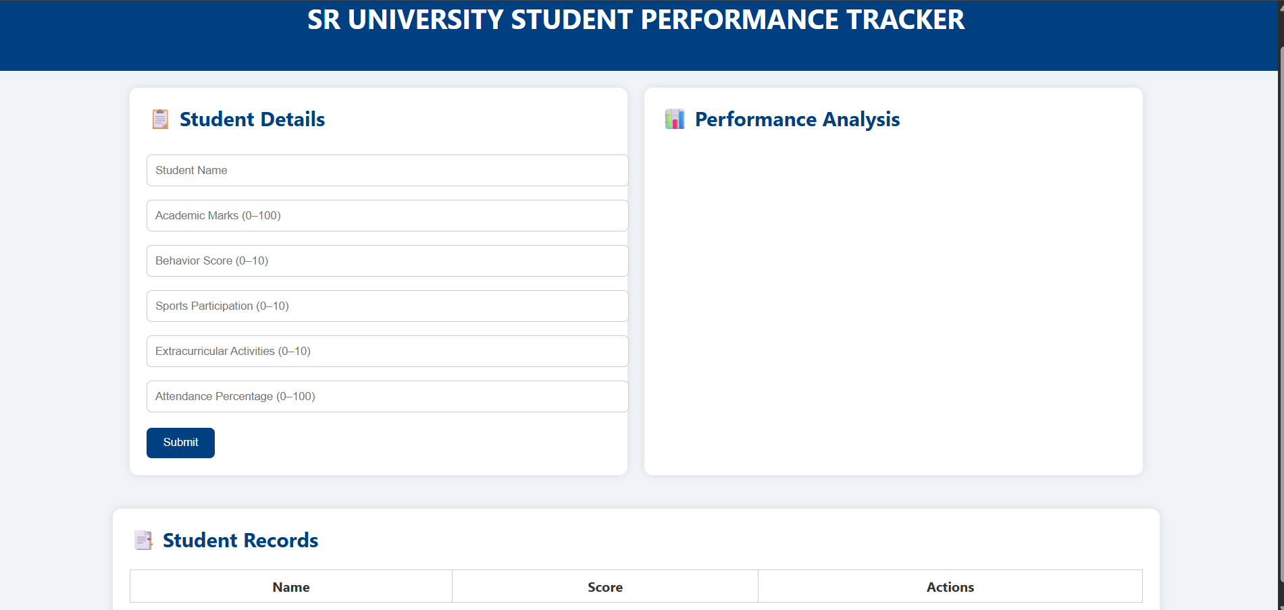
FRONTEND VIEW

Slide 11

CONCLUSION
The Student Performance Tracker is a robust, user-friendly web application designed to evaluate and visualize student performance across academic, behavioral, and extracurricular domains
Real-time calculation of overall performance using a weighted formula Dynamic feedback with compliments and identification of weak areas Interactive bar chart visualization for category-wise contribution

Slide 12
THANK YOU
PRESENTED BY ASHWITHA PABBA (2403A52223) MEGHANA KANNE (2403A52247) DHRUVAJA (2403A52224)

